Slide 1
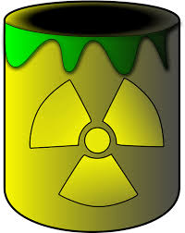
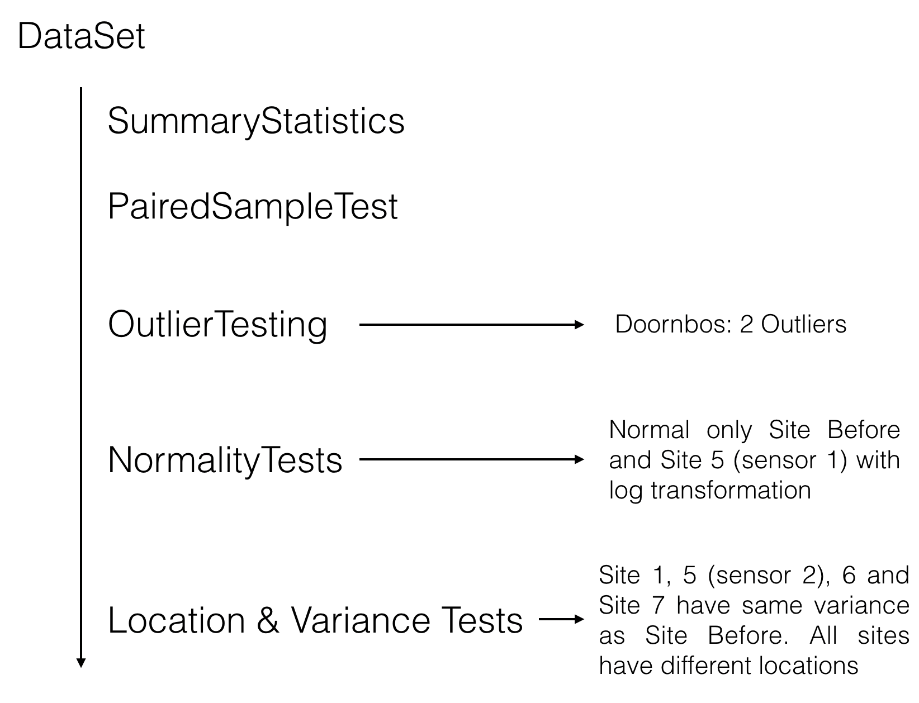




Accident Report
Are the measured PPM values at the different sites worse than normal level?
Problem Statement:
An accident occurred in the factory and there is concern of release of a toxic substance at different site of the factory. Hence the levels of PPM were measured using 2 sensors on 7 sites hourly, up to 4 hours.
Analysis & Procedure
Research Results
Site 1 and 2 are not worse than normal level (safe).
Site 3, 4 and 6 are worse than normal level (unsafe).
Site 5 and 7 We cannot say.
Site 1
Site 2
Site 3
Site 4
Site 5
Site 6
Site 7

